Slide 1

MACHINE LEARNING FOR MEDICAL DIAGNOSIS
DSCI-6612-02 Intro to Artificial Intelligence
Professor : Vahid Behzadan
Team Members : Kusuma Sirimalla
Chandramohan Chandanakumar

Slide 2

Project Topic
Project Objectives
Approach
Deliverables
Evaluation Methodology

Slide 3
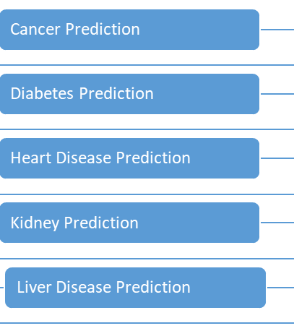
Project Objectives
Collect diverse and comprehensive medical datasets for targeted conditions.
Clean and preprocess data to ensure accuracy and completeness.
Identify and optimize key diagnostic features for each medical condition.
Select and train machine learning models tailored to each diagnosis for optimal accuracy.
Define and measure performance metrics specific to each medical condition for effective model evaluation.
Validate models rigorously using diverse datasets to ensure reliability and generalizability.
Establish mechanisms for ongoing monitoring, updates, and incorporation of the latest medical knowledge.

Slide 4

Approach
Collect diverse and extensive medical datasets for cancer, diabetes, kidney, liver, and heart conditions. Clean and preprocess the data to ensure quality and consistency, handling missing values and outliers.
Identify and optimize key diagnostic features for each medical condition to enhance model performance. Choose and train machine learning models tailored to each diagnosis, considering algorithmic suitability.
Define and measure relevant performance metrics for each condition to assess model accuracy. Create a scalable system capable of handling new data and accommodating diverse patient populations.
Adhere to healthcare regulations, ensuring data security and compliance with legal standards. Establish mechanisms for ongoing monitoring, updates, and incorporation of the latest medical knowledge.

Slide 5

Deliverables
Final report summarizing the project findings
Developed machine learning models for each disease
Prototype for the integration of the models into clinical workflows
Publication of research findings in relevant journals and conferences

Slide 6

Evaluation Methodology
Feature Engineering
Model Development
Model Interpretation
Ethical Considerations
Deployment and Validation

